Slide 1

Intro to the CSBC/PS-ON Summer Undergraduate Research Program & miniDREAM ‘Challenge’

Slide 2
Agenda
Welcome from the NCI - Dan Gallahan
Introductions
Overview of NCI, CSBC & PSON - Erin Wetzel, Shannon Hughes & Nas Zahir
Goals, Expectations & Supplemental Activities this summer – Erin Wetzel & Doro Noble
Synapse & R-studio Overview - Milen Nikolov
Mini-DREAM Intro - Diana Murray

Slide 3
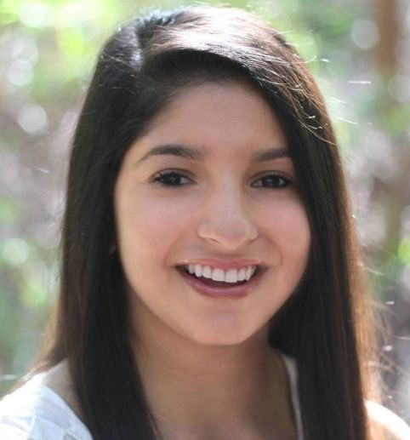
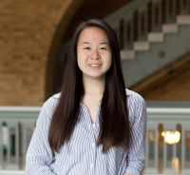
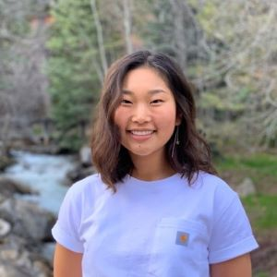
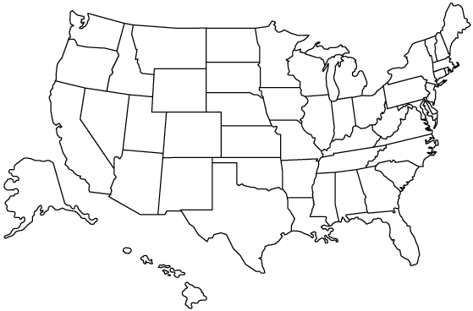
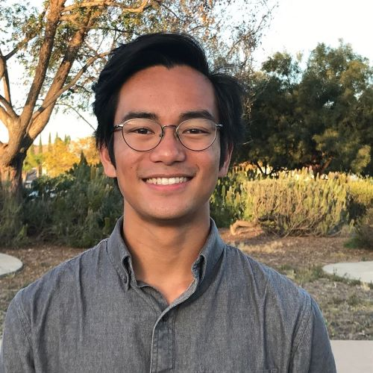
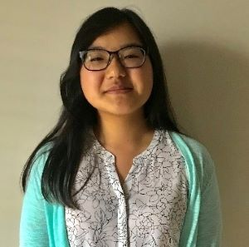
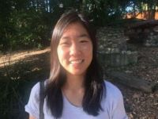
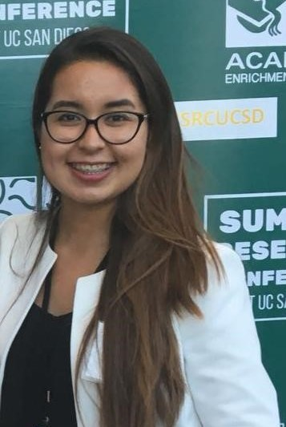
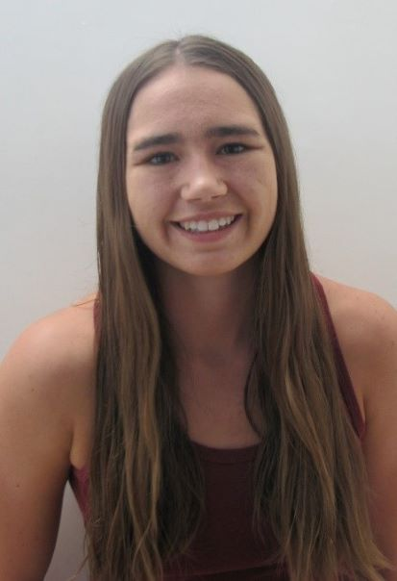
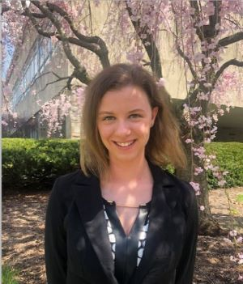
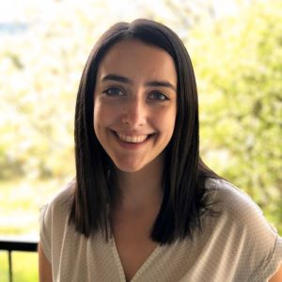
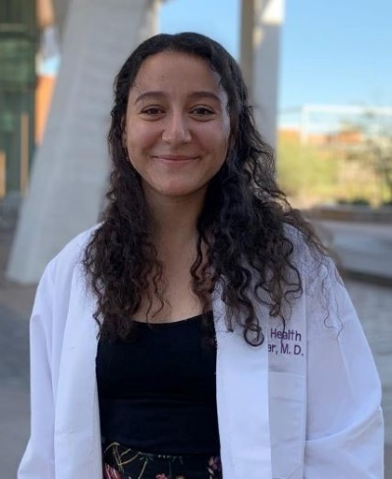
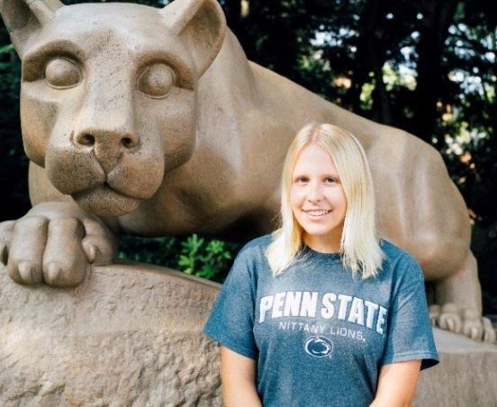
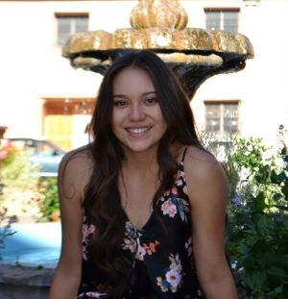
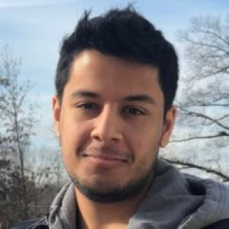
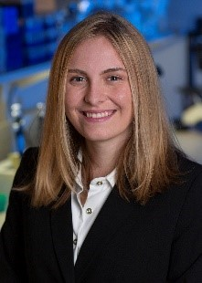
CSBC
Beulah D.
Sceptre G.
Kimya G.
PS-ON
Erica S.
Victoria Q.
Kristin K.
Daphne C.
Crystal M.
Oscar C.B.
Madelyn M.
Jimena C.
Lizeth L.V.
Kinsey V.
Stephie L.
Maya S.
Rachel S.
Rachel L.
Maribel G.K.
2019 Cohort
Saurav P.
Megan J.

Slide 4

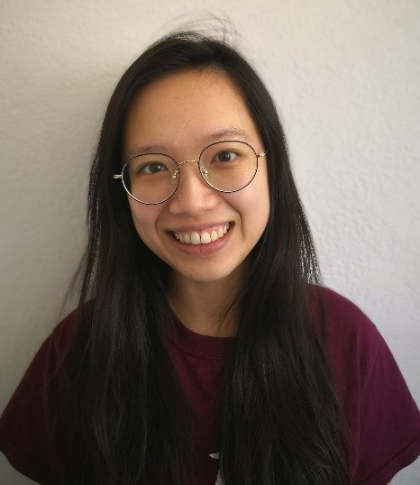
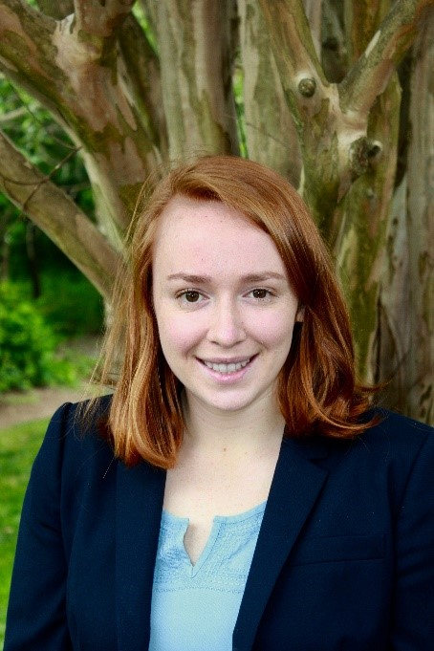

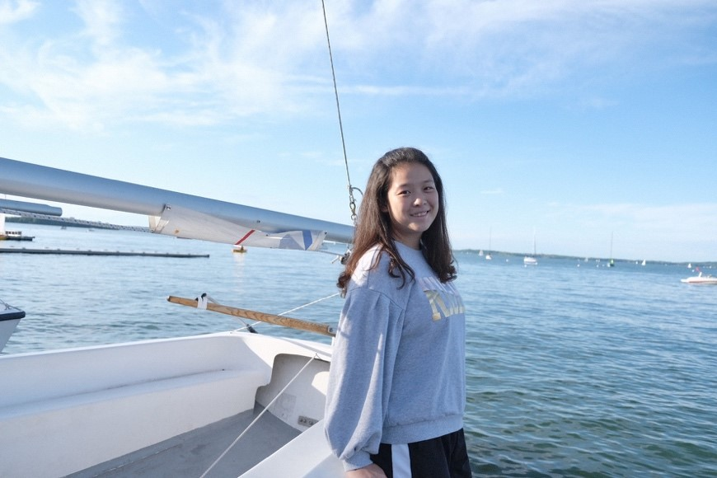
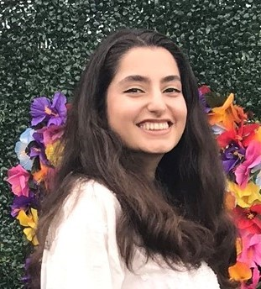



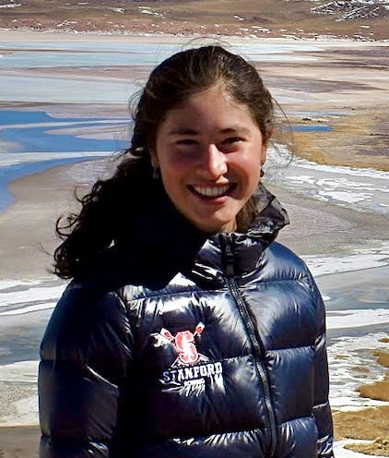
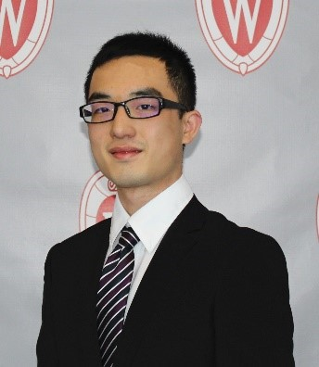
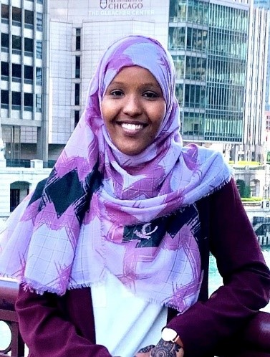
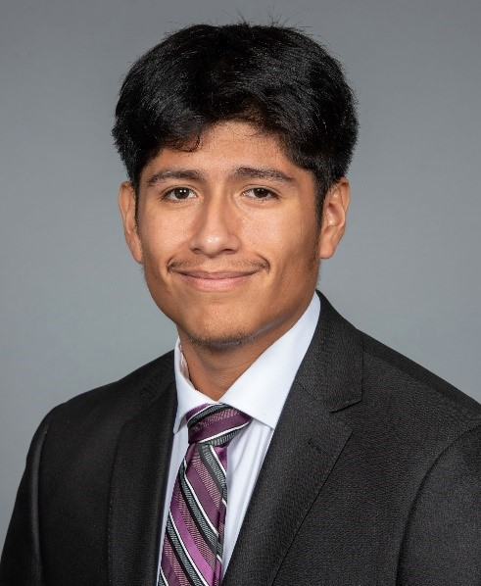
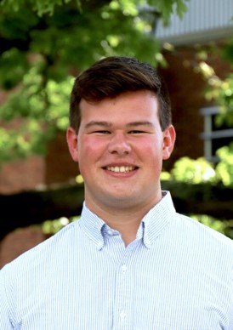
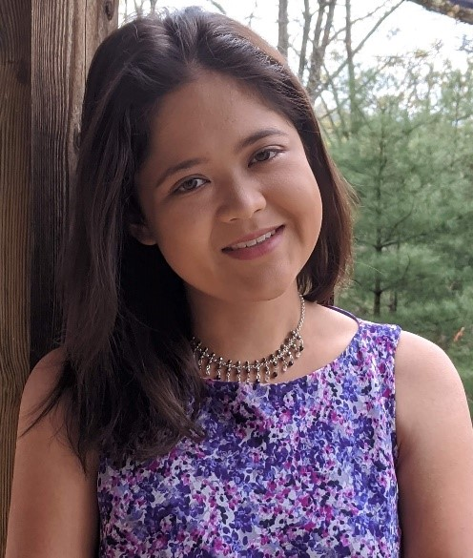
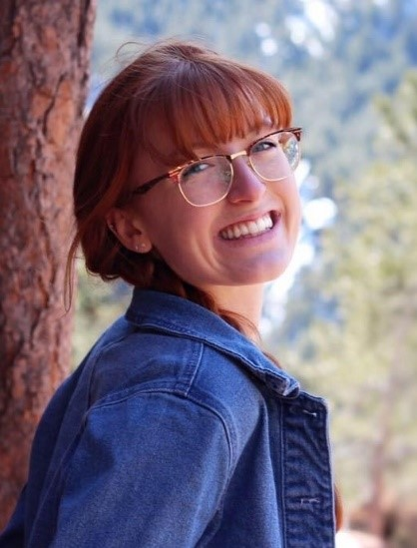

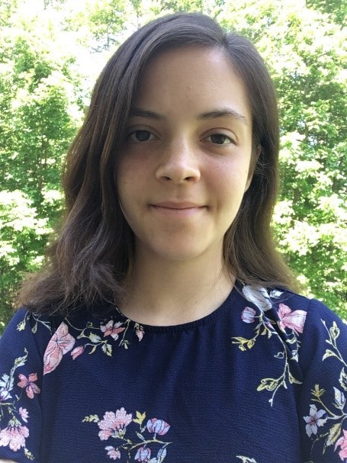

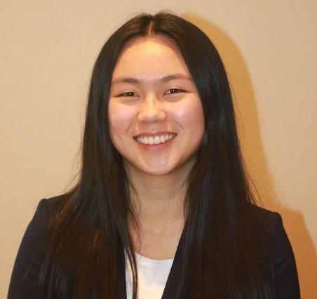
2020 Cohort
Yingxi L.
Sylvia S.
Emma G.
Anahid F.
Sahil A.
Kaitlin H.
Justin C.
Daniel W.
Songyang C.
Cora W.
Tara M.
John Q.
Anab M.
Sameer C.
Gabrianne I.
Miranda S.
Luka K.
Cort B.
Emma W.
Skylar M.

Slide 5
NCI Program Staff: Erin Wetzel, Shannon Hughes, and Nas Zahir
Leidos Biomedical Research Staff: Teresita Larida & Bill Bocik
Sage Bionetworks Team: Milen Nikolov & Xengie Doan
MiniDREAM Instructors: Diana Murray, Andrew Gentles, Philip Moos, Jeffrey Chang, James Eddy, Jay Hou, Andrea Bild

Slide 6
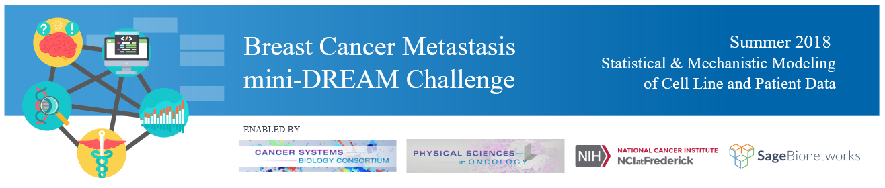
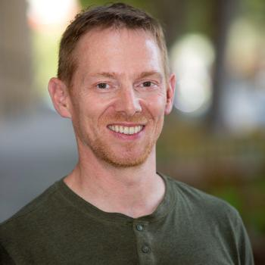
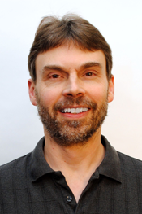
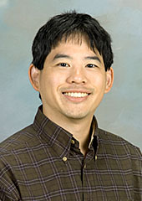
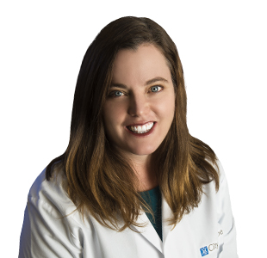
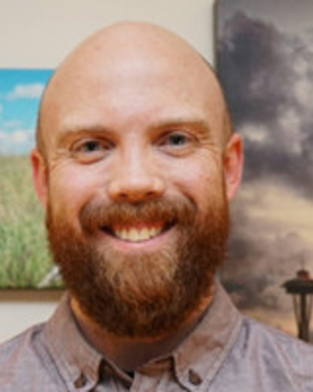
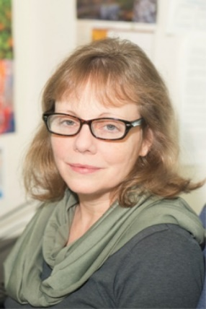
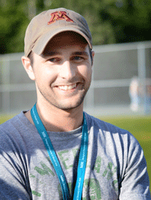

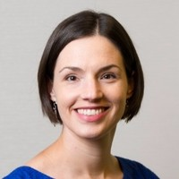
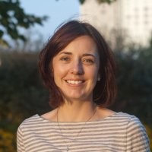
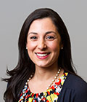
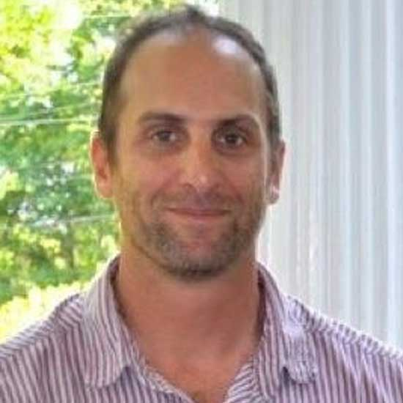
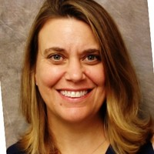
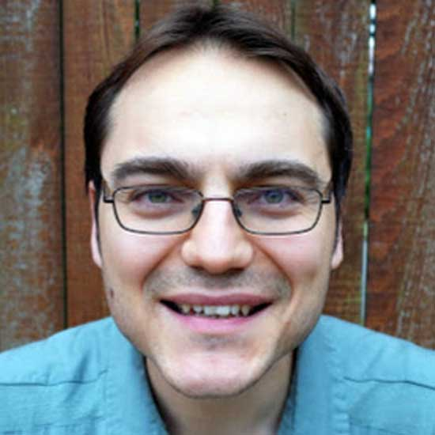
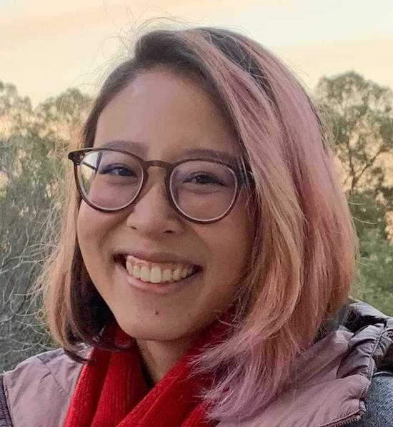
Summer 2020
Julie Bletz
Andrew Gentles
Stanford
Philip Moos
U Utah
Jeffrey Chang
U Texas
Andrea Bild City of Hope
James Eddy
Sage
Diana Murray
Columbia
Brian Castle
U Minnesota
Jay Hou
U Minnesota
Erin Wetzel
Shannon Hughes
Nas Zahir
Justin Guinney
Julie Bletz
Milen Nikolov
Xengie Doan

Slide 7
National Institutes of Health (NIH)
“NIH is the largest public funder of biomedical research in the world, investing more than $30 billion in taxpayer dollars to achieve its mission to enhance health, lengthen life, and reduce illness and disability. In pursuing this mission, NIH improves health by promoting treatment and prevention, contributes to society by driving economic growth and productivity, and expands the biomedical knowledge base by funding cutting-edge research and cultivating the biomedical workforce of today and tomorrow.”
The National Institutes of Health is made up of 27 different components called Institutes and Centers, the largest of which is the National Cancer Institute
Source: https://www.nih.gov/about-nih

Slide 8
National Cancer Institute
The National Cancer Institute (NCI) is the federal government's principal agency for cancer research and training.
Leads the nation’s research efforts to improve cancer prevention, detection, diagnosis, and survivorship
Supports 71 NCI-Designated Cancer Centers and more than 5,000 grantees
As a federal agency, NCI receives its funds from Congress. The bulk of our budget supports extramural grants and cooperative agreements to facilitate research conducted at universities, medical schools, hospitals, cancer centers, research laboratories, and private firms in the United States and abroad.
Source: https://www.cancer.gov/about-nci/overview#mission-statement

Slide 9

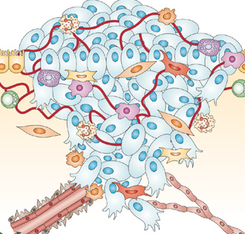

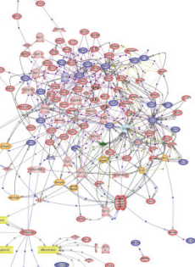

NCI, Division of Cancer Biology
Our Mission:
To ensure continuity and stability in basic cancer research while encouraging and facilitating the emergence of new ideas, concepts, technologies and possibilities through a broad portfolio of Investigator initiated research and specialized NCI programs.
Cellular Interactions
Physiological Systems
Environment
Signaling Networks
Genomic Alterations

Slide 10
>1.8M Americans will be diagnosed with cancer in 2020
*These numbers exclude skin cancers and in situ carcinomas except urinary bladdar
ACS 2020 Cancer Statistics:
https://www.cancer.org/research/cancer-facts-statistics/all-cancer-facts-figures/cancer-facts-figures-2020.html
Notes:
Cancer is a debilitating disease that continues to be a leading cause of death. Cancer is the 2nd leading cause of death in the US and projected to kill nearly 600,000 Americans in 2016. The number of newly diagnosed Americans in 2016 is estimated to be more than 1.6 million, which is roughly 4600 new diagnoses each day.

Slide 11
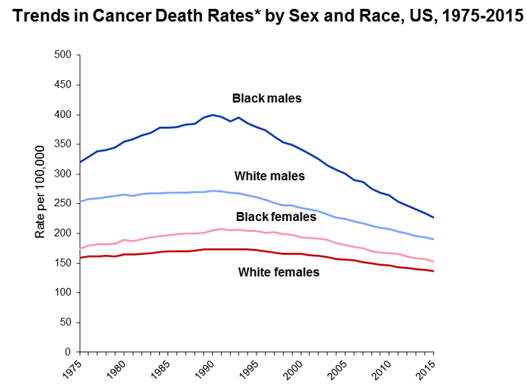
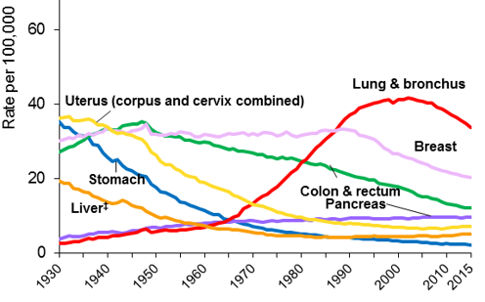
But…Progress is Hopeful and More Work Needs to be Done
The incidence of cancer is decreasing for the most common types – but there are exceptions
Female Cancer Death Rates (to 2015)
Modified from ACS 2018 Cancer Statistics: http://bit.ly/Cancer_stats
Notes:
Cancer is a debilitating disease that continues to be a leading cause of death. Cancer is the 2nd leading cause of death in the US and projected to kill nearly 600,000 Americans in 2016. The number of newly diagnosed Americans in 2016 is estimated to be more than 1.6 million, which is roughly 4600 new diagnoses each day.

Slide 12

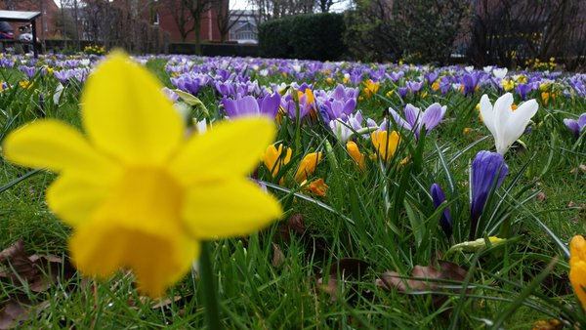

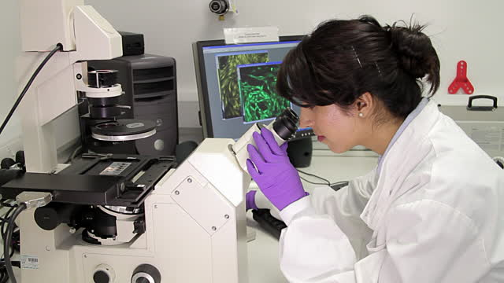
Can we bring new approaches to cancer research? How Things Appear is Always a Matter of Perspective . . .
Notes:
So new approaches and perspectives are needed to understand the complexity, of cancer and that has been the premise of bridging physical sciences with oncology at the NCI since 2009. Physical sciences perspectives & approaches provide complementary, new insights to understanding and treating cancer. Mathematicians, physicisits, engineeris,chemists and other physical scientists bring a complementary viewpoint from clinicians and biologists and that is why you are working together.

Slide 13

The PS-ON and CSBC investigators bring new approaches to cancer research
Multiple Viewpoints = Enhanced Insight & Efficient Problem Solving
Complex Cancer Questions
New theory
Mathematical modeling
Big data analysis
Physical science-based measurements
High-throughput measurements
Modified figure from systemsbiology.org

Slide 14

Cancer Systems Biology Consortium (CSBC)
*13 Research Centers
*20 Research Projects
www.csbconsortium.org
@NCISysBio
Physical Sciences-Oncology Network (PS-ON)
*10 Research Centers
*17 Research Projects
www.physics.cancer.gov
@NCIPhySci
Check out CSBC and PS-ON research on the Cancer Complexity Knowledge Portal:
https://www.cancercomplexity.synapse.org/

Slide 15
Summer Program Goals:
Each summer we aim:
To provide a new experience to push you past your “comfort zone”
To facilitate an understanding and appreciation of major questions currently under investigation within the CSBC and PS-ON through mentored research projects and/or laboratory work, faculty lectures, seminars, discussions and other activities.
To help you achieve a better idea of what you do (and don’t!) like in the research field
Some COVID-19 modifications…
To provide a worthwhile learning experience
To continue training the next generation of cancer systems biologists safely while dealing with a global pandemic
To help you gain exposure to new scientific concepts and make connections across the scientific community

Slide 16
Program Expectations:
You have some expectations of us:
That we have designed a summer experience that will be challenging, novel, and fun.
That your workload is reasonable and expectations are clear
That we will treat you with respect
That we will give everyone an equal chance at success
We have some expectations of you:
That you will attend the videoconferences prepared to learn and excited for the challenge
That you will ask if expectations are not clear
That you will treat everyone with respect
That you will offer honest and frequent feedback

Slide 17
2020 Summer Team Activities:
Mini-DREAM Challenge
Kick-off TODAY!
Goal: Introduction to big-data analysis and modeling in breast cancer
What you’ll learn:
Biology of breast cancer metastasis
Statistical analysis in R and mechanistic modeling in matlab
How to use the Synapse virtual collaboration space
Additional Activities
Cancer Survivors and Advocates Presentation – Please mark your calendars!
July 13, 2020 – 3 – 5 pm ET (12 – 2 pm PT)
Online Enrichment Activities: https://dream-high.org/enrichment-activities
Access to Labster modules for the summer – more information & account information coming soon!
Yale REU summer sessions – Doro Noble

Slide 18
Thank you!
Please contact us with any questions:
erin.wetzel@nih.gov
shannon.hughes@nih.gov

